Slide 1
The Battle of Neighborhoods Toronto and New York neighborhoods clustering
Tomasz Kania
16 June 2019

Slide 2
Introduction
Compare the neighborhoods of the two cities, Toronto and New York and determine how similar or dissimilar they are
Company ABC has headquarter on New York, Somerville, is satisfied with the location and surroundings – Park, Yoga Studio venues
They are looking for location, to open a branch in Toronto. One of the requirement is to choose the neighborhood, which is very similar to one in New York
Is it possible to determine neighborhoods similar to one in New York based on popular venues located in each neighborhood ?

Slide 3
Data
New York City Neighborhood Names https://geo.nyu.edu/catalog/nyu_2451_34572
Toronto postal codes from wiki page https://en.wikipedia.org/wiki/List_of_postal_codes_of_Canada:_M
Toronto geospatial data https://cocl.us/Geospatial_data
Data about popular venues for each neighborhood - Foursquare API (https://foursquare.com)

Slide 4
Metodology
Use Foursquare API and cities location data to get popular venues for each neighborhood in New York and Toronto
Segmenting and clustring for all neighborhoods in both cities together, based on all popular venues in each neighborhood, only food and drink related, not food and drink related
use K-means clustering algorithm. Similar neighborhoods of New York and Toronto, should be labeled in the same cluster

Slide 5
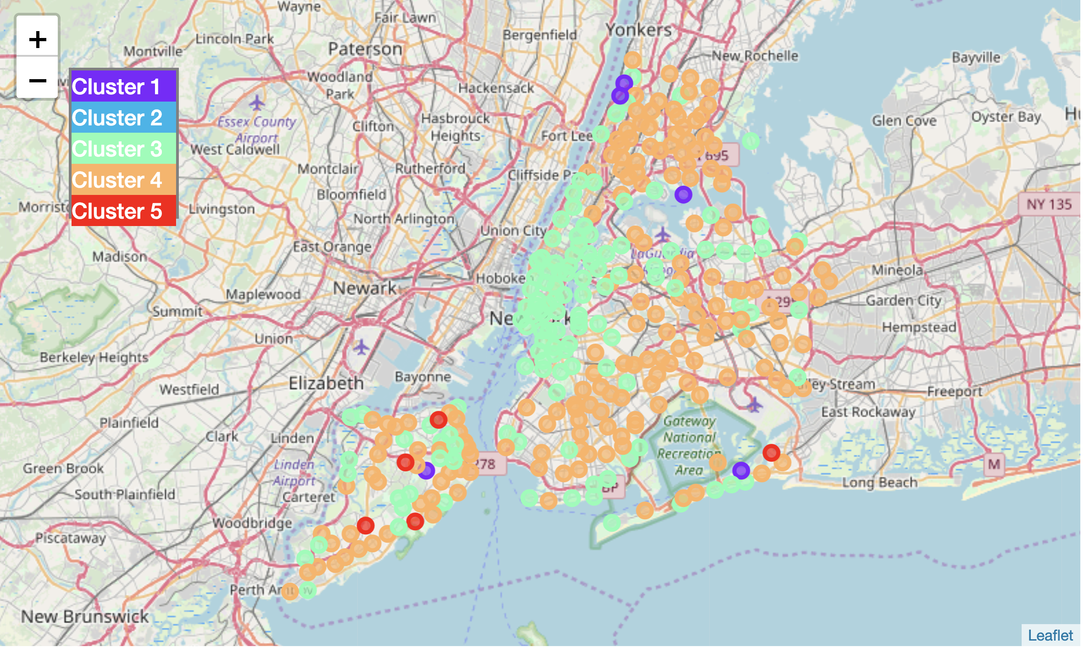
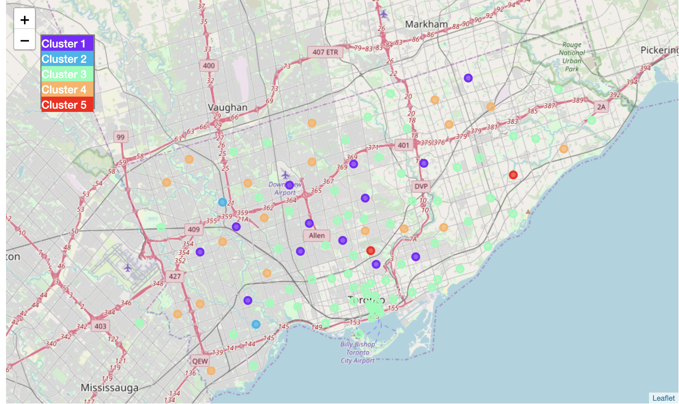
Results – clusters based on all popular venues

Slide 6
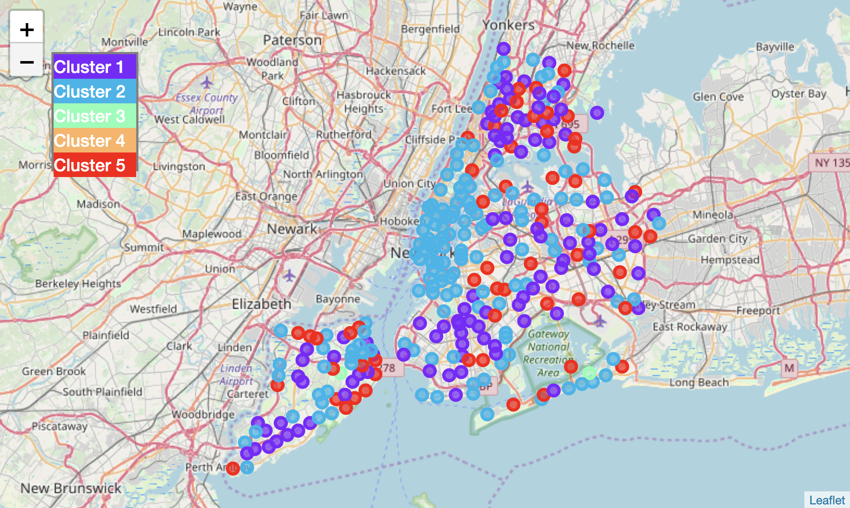
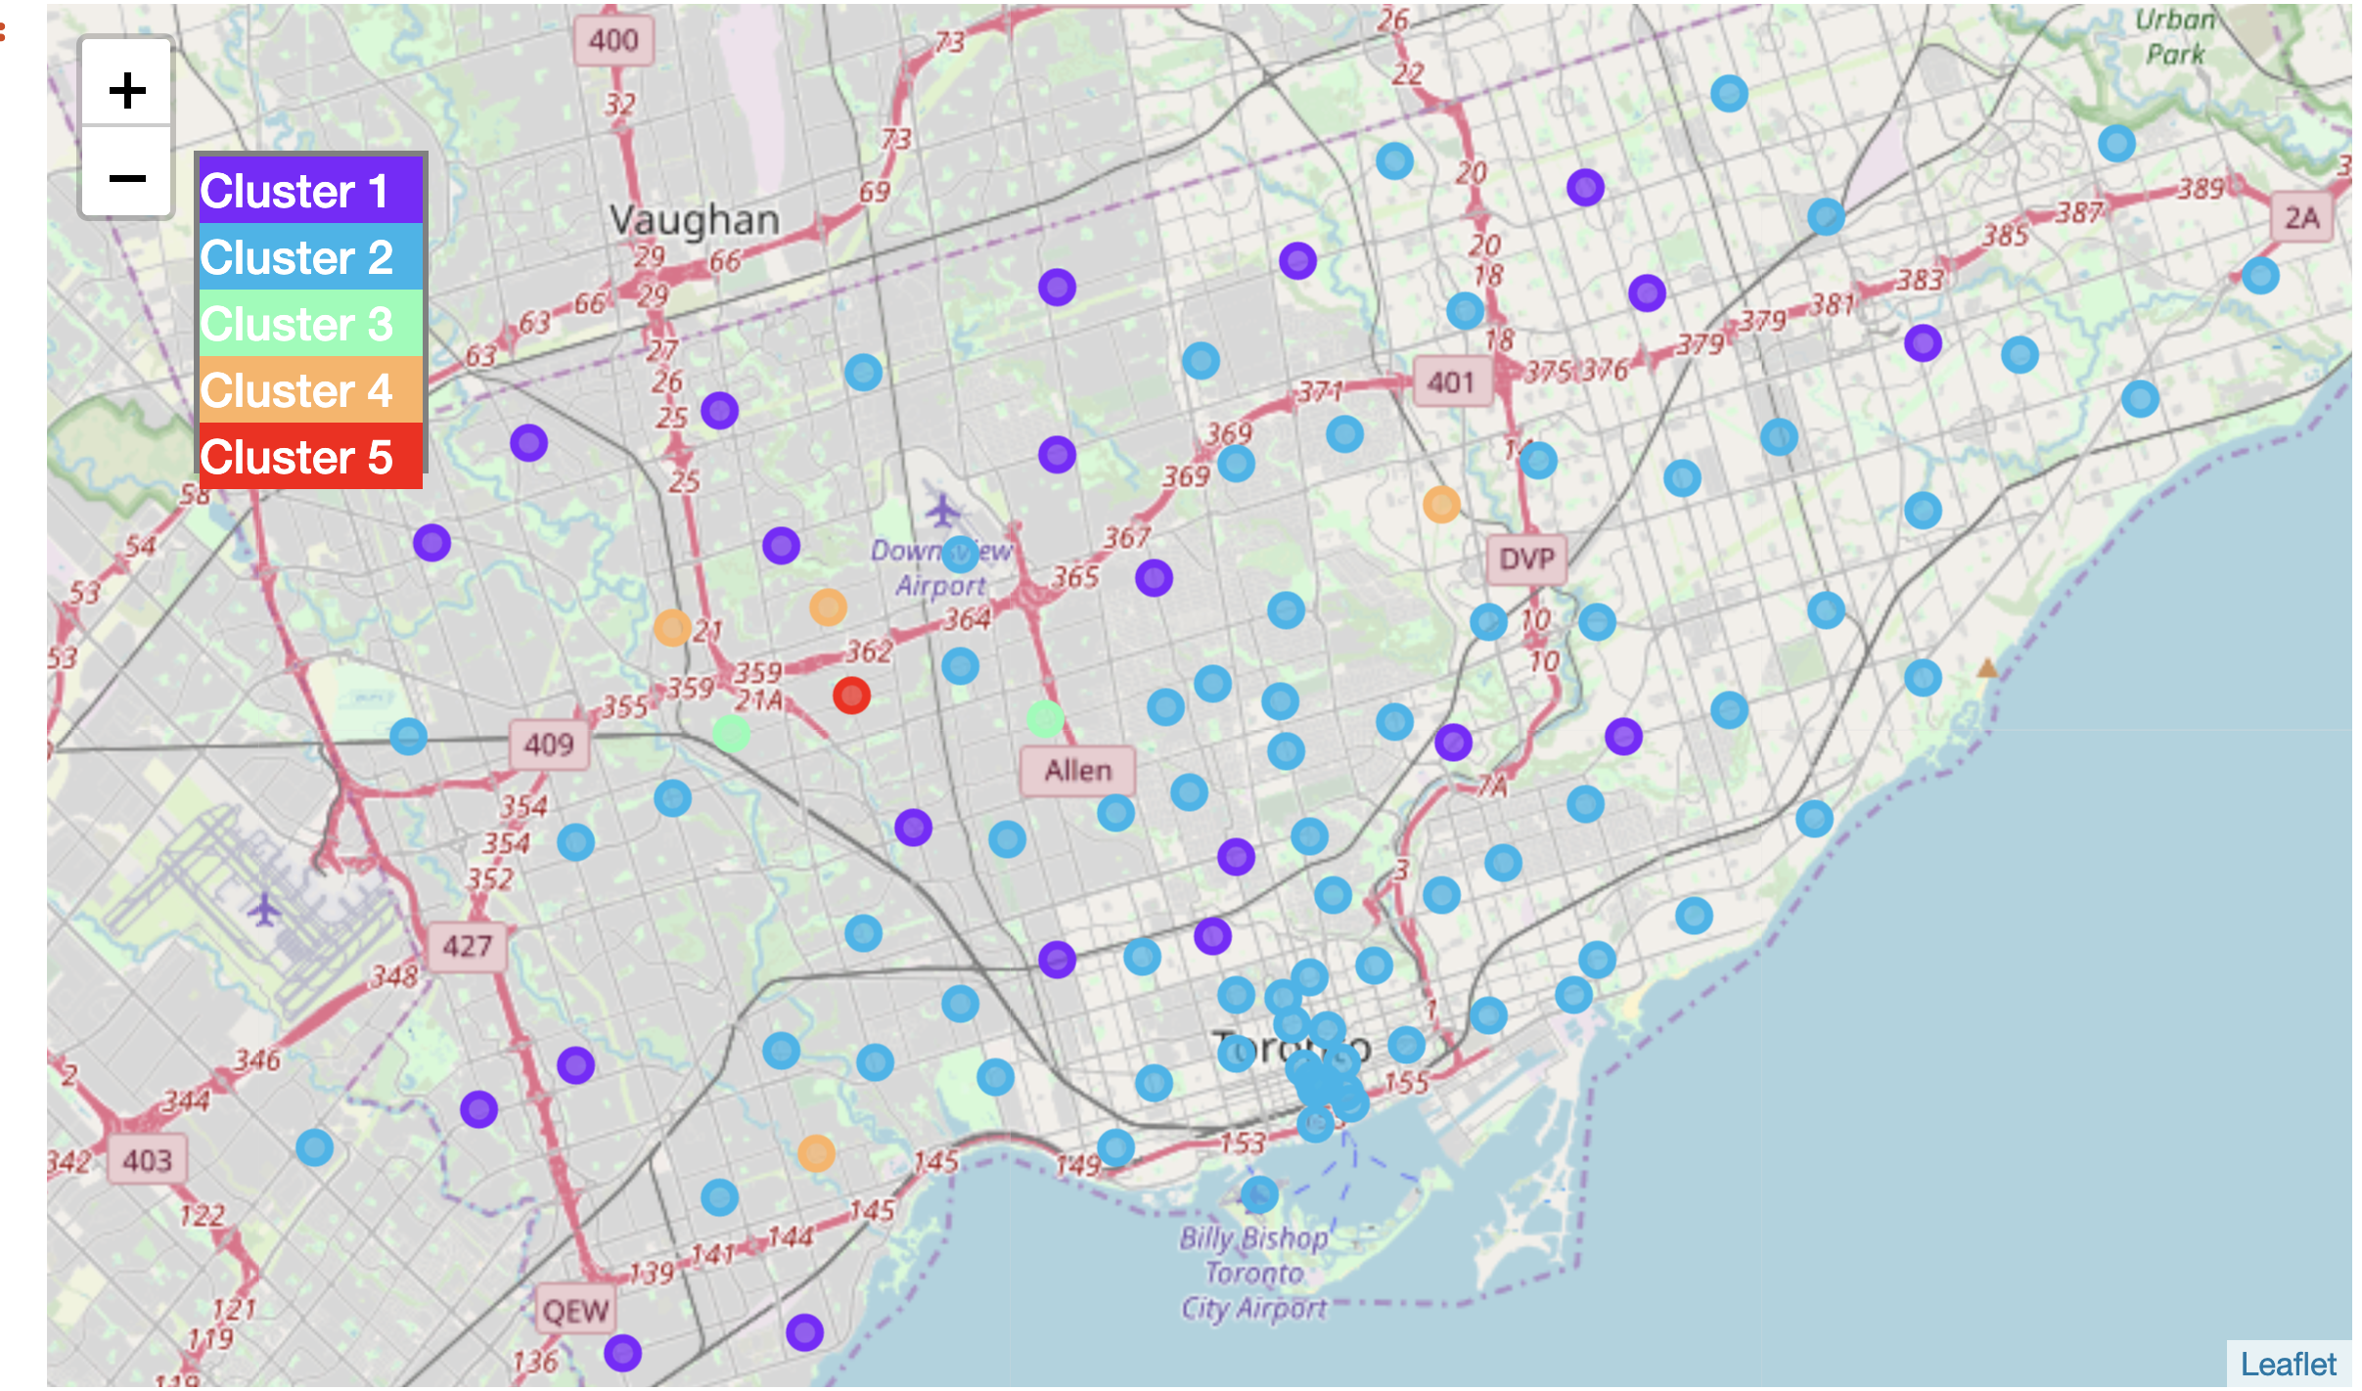
Results – clusters based on not food/drink related venues

Slide 7
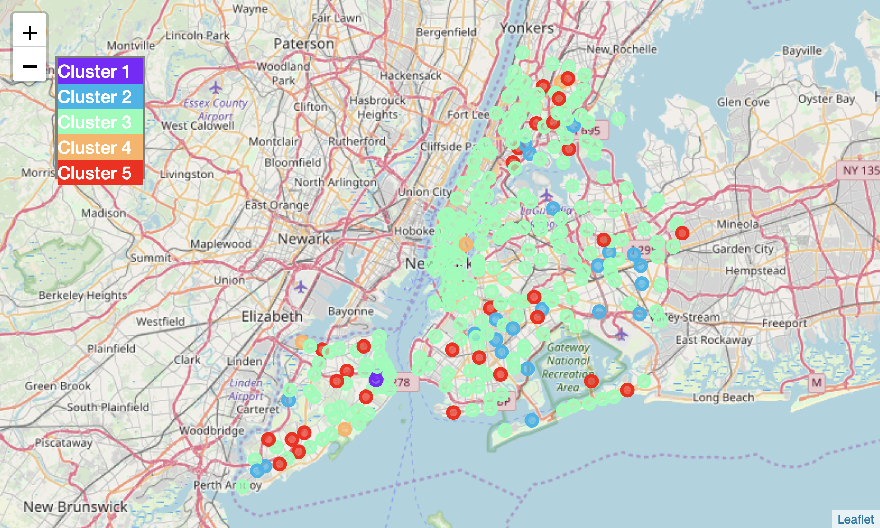
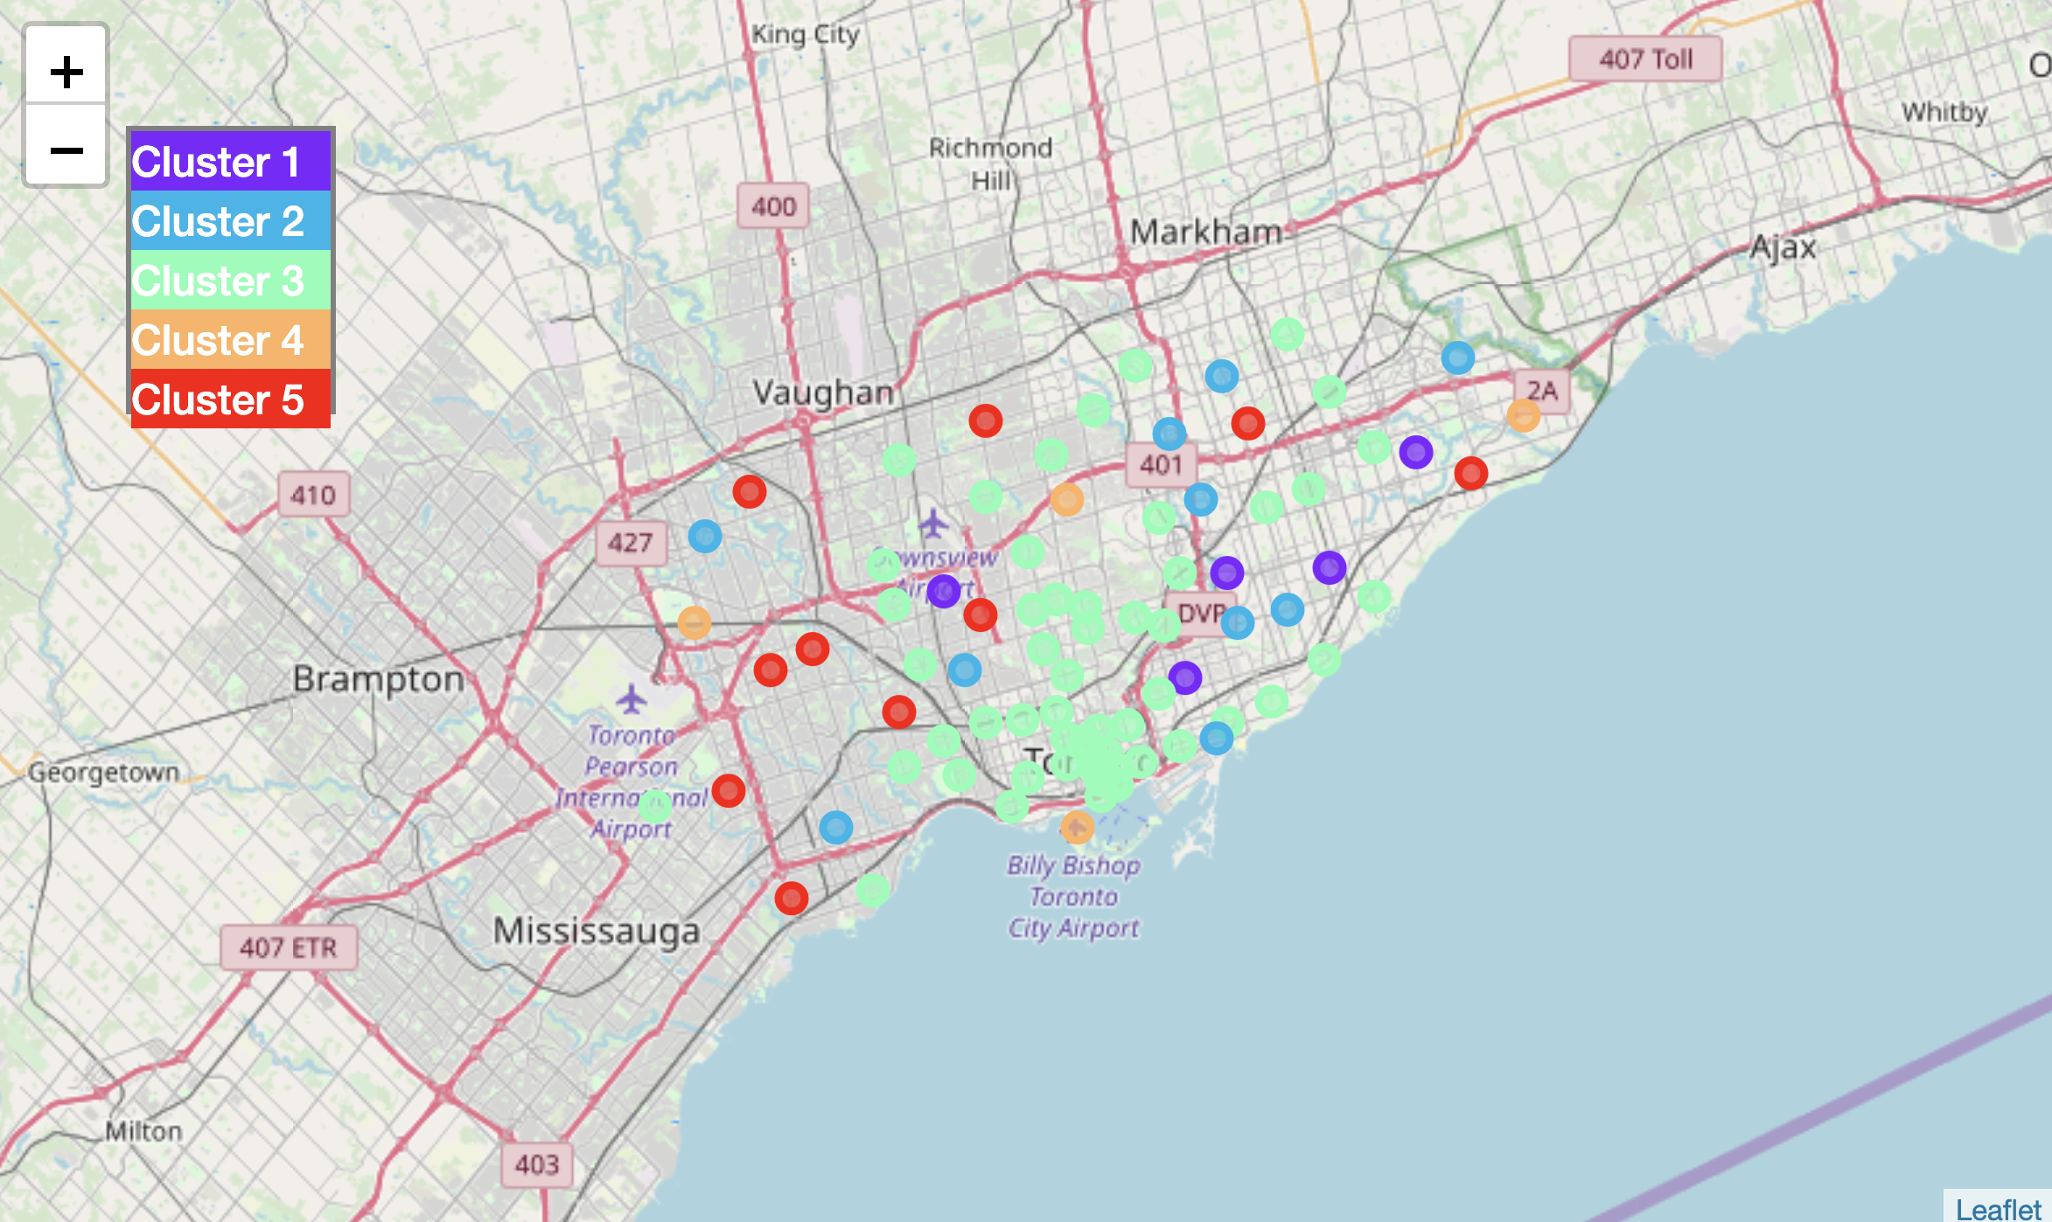
Results – clusters based on only food/drink related venues

Slide 8
Results – possible locations for company ABC based on all popular venues
City | Neighborhood | 1st Most Common Venue | 2nd Most Common Venue | 3rd Most Common Venue | 4th Most Common Venue | 5th Most Common Venue | 6th Most Common Venue | 7th Most Common Venue | 8th Most Common Venue | 9th Most Common Venue | 10th Most Common Venue
New York | Somerville | Park | Yoga Studio | Electronics Store | English Restaurant | Ethiopian Restaurant | Event Service | Event Space | Exhibit | Eye Doctor | Factory
Toronto | Parkwoods | Fast Food Restaurant | Food & Drink Shop | Park | Yoga Studio | English Restaurant | Ethiopian Restaurant | Event Service | Event Space | Exhibit | Eye Doctor
Toronto | Lawrence Park | Swim School | Park | Bus Line | Yoga Studio | Field | Ethiopian Restaurant | Event Service | Event Space | Exhibit | Eye Doctor
Toronto | Rosedale | Park | Trail | Playground | Yoga Studio | Egyptian Restaurant | Empanada Restaurant | English Restaurant | Ethiopian Restaurant | Event Service | Event Space
Toronto | Glencairn | Japanese Restaurant | Park | Pub | Pizza Place | Yoga Studio | Fast Food Restaurant | English Restaurant | Ethiopian Restaurant | Event Service | Event Space
Toronto | Weston | Park | Yoga Studio | Electronics Store | English Restaurant | Ethiopian Restaurant | Event Service | Event Space | Exhibit | Eye Doctor | Factory

Slide 9
Results – possible locations for company ABC based on popular venues not related with food or drink
City | Neighborhood | 1st Most Common Venue | 2nd Most Common Venue | 3rd Most Common Venue | 4th Most Common Venue | 5th Most Common Venue | 6th Most Common Venue | 7th Most Common Venue | 8th Most Common Venue | 9th Most Common Venue | 10th Most Common Venue
New York | Somerville | Park | Yoga Studio | Fountain | Electronics Store | Event Service | Event Space | Exhibit | Eye Doctor | Factory | Farm
New York | Todt Hill | Park | Yoga Studio | Fountain | Electronics Store | Event Service | Event Space | Exhibit | Eye Doctor | Factory | Farm
Toronto | Glencairn | Park | Yoga Studio | Fountain | Electronics Store | Event Service | Event Space | Exhibit | Eye Doctor | Factory | Farm
Toronto | Weston | Park | Yoga Studio | Fountain | Electronics Store | Event Service | Event Space | Exhibit | Eye Doctor | Factory | Farm

Slide 10
Discussion
Some neigherhoods in New York and Toronto are almost identical in case of distribution of popular venues. Unfortunatelly few clusters where quite big without clear similarities, especially in cases where venues distribution were similar e.g. small differences in mean for most common categories.
It's possible for Company ABC located in New York, on neigherhood Somerville, to find similar neigherhood in Toronto for new location. To get better results, Company ABC should specify exactly which venues categories are important, e.g. Park, Playground, Garden to do clustering better.
Company ABC could also specify additional requirements, e.g. neighborhood similar to existing one, but with more Parks and Coffe Shops. Then I could get data from Foursquare API for current Company ABC location, calculate how common different popular venus are, manipulate the results (e.g increase means for Park and Coffe Shops venue categories), and do clustering. This way I could find even better location in Toronto for Company ABC
During clustering on all and other then food/drink venues, I've found few neigherhoods in Toronto, which are very specfic, and there is not similar neighborhood in New York city

Slide 11
Conclusion
Using Foursqare API and venues data is very powerful tool, to solve and address many objectives. It seems it especially helpful for looking for location to open a business, place new branch for company, or rent a flat
Based on location data from Foursqare API, we can check the similarity or dissimilarirty of different location and neighborhoods, in different cities around the World
We can also do classification of area located inside the city

